Slide 1

Predicting Visa Application Status
Term Project, CDS 403: Sofia Escoto

Slide 2
Overview
Dataset and goals
Chosen method
Data loading and cleaning
Modelling
Optimization
Future work and applications
Questions?

Slide 3
Dataset and Goals
Dataset provided to Kaggle by Sujan Shirol called “USA Foreign Workers Salary”
Given that immigration is such an important issue I wanted to classify visa applications by status in the hopes of using this to predict whether a visa application will be accepted
Applications of this model could include helping people maximize their chances of getting approved for a visa, social study on possible biases or discrimination in the acceptance of visas, and more.

Slide 4
Choosing a method
I chose to use a decision tree model to classify application statuses as either accepted (certified) or rejected (denied)
Decision tree pros:
Easy to understand results
Can be visualized
Can use categorical and numeric variables
Decision tree cons:
Can overfit data easily (must be validated on a test set)
Unbalanced classes can create biased outcomes

Slide 5
Data loading and cleaning
I started out with over 167,000 rows of 26 features
All features were encoded as characters, so I formatted all accordingly (dates, numeric)
Some units were inconsistent
A variable called paid_wage was also given with paid_wage_units, meaning that some salaries were given as an hourly or dayly wage, some as a weekly or biweekly, and some as a yearly salary
I standardized them all and converted that information into a new variable called calculated_paid_wage_py
Status were inconsistently categorized (certified-withdrawn, certified-expired, etc.) so I changed all statuses as either certified or denied, depending on their main category.
I converted remaining character features into factors so that R could deal with them

Slide 6
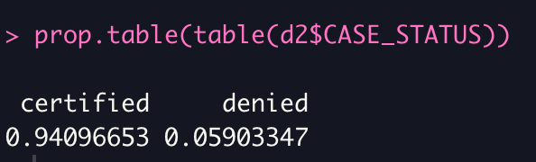
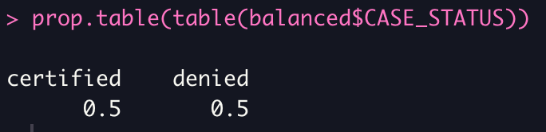
Balancing classes
Decision trees can be easily swayed by unbalanced classes, which I knew was a problem when I ran a prop table to see my distribution
I decided to use the caret package to bootstrap my data, upsampling so that I wouldn’t lose any information but would still end up with balanced classes.
The end result turned out well

Slide 7
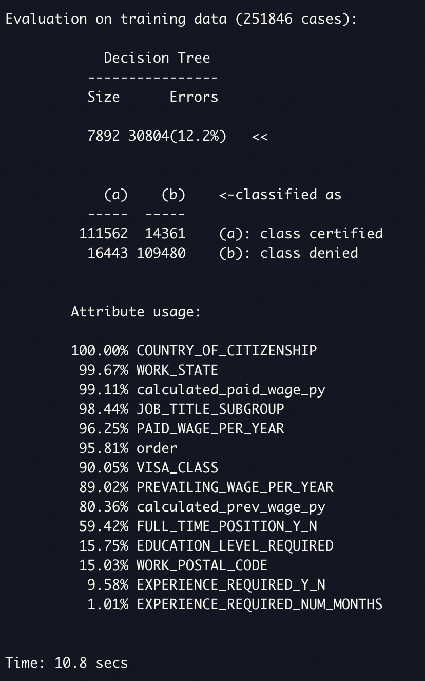
Modelling
After splitting up the data into training and testing sets, I made my first model with C5.0() from the C50 package to predict case_status
Country of citizenship, work state, paid wage per year, and job title all had a large impact on whether the application was approved or not
My error was 12.2% which wasn’t bad, but since decision trees tend to overfit, I needed to look at how the model did on the test set

Slide 8
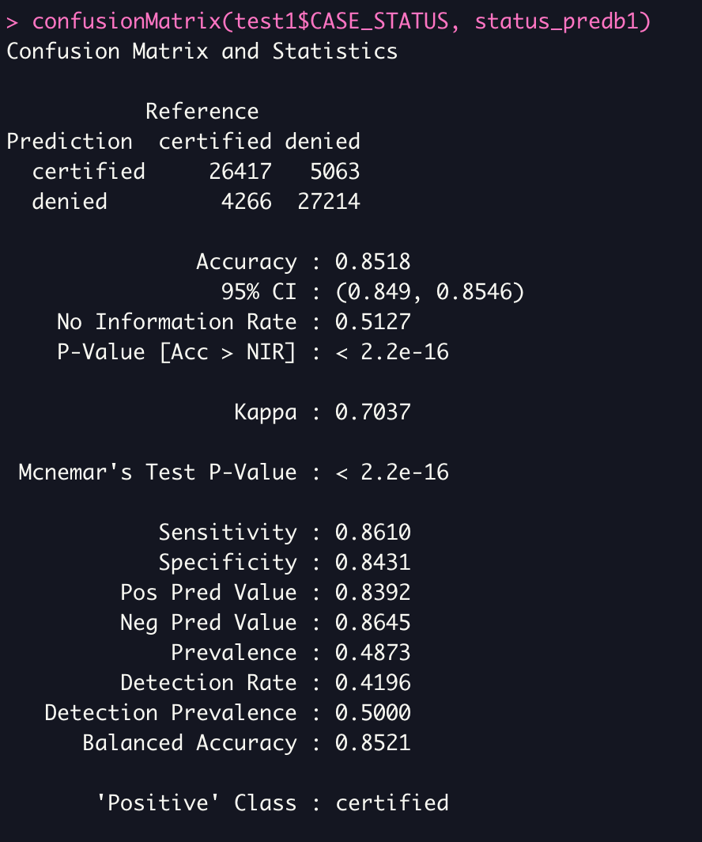
Evaluating the model
All of my summary statistics were pretty good, with an overall accuracy of 85% and sensitivity and specificity almost equal
I was sure I could improve upon this with boosting

Slide 9
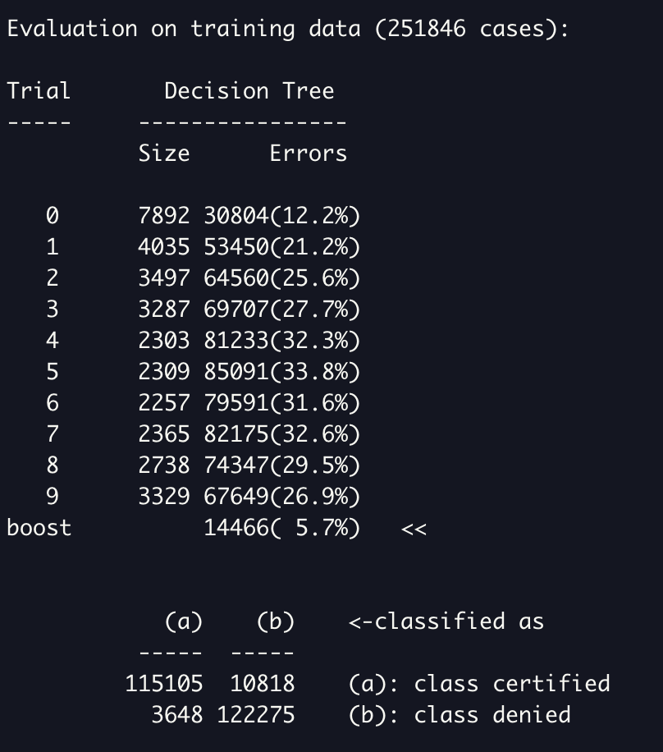
Optimizing my model (boosting)
Boosting a model takes many trials of a decision tree and combines them together so that many weak learners can form a strong model
Even though my old model wasn’t necessarily weak, I wanted to see how much I could improve my model with boosting
I set 10 trials to repeat and got my error down to 5.7% from an original 12.2%

Slide 10
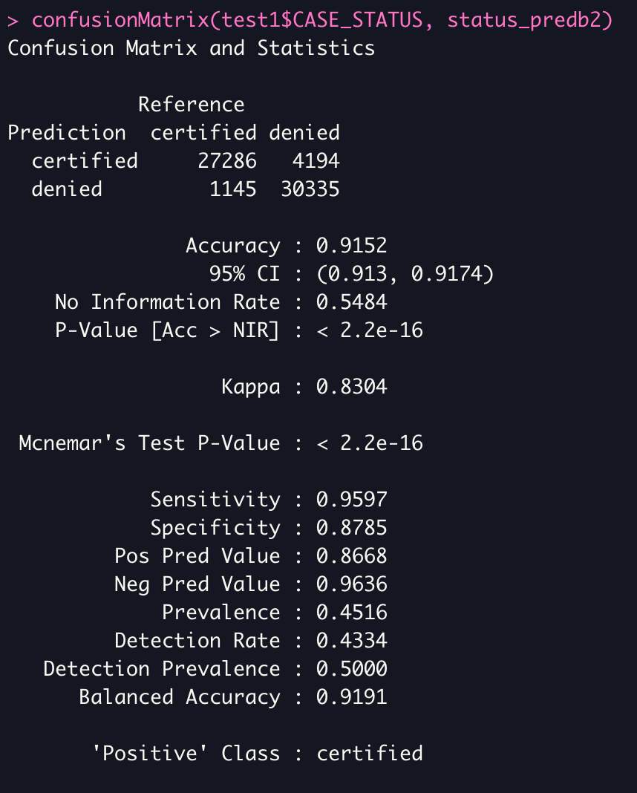
Evaluating my boosted model
When my boosted model was used on my test set I got an overall accuracy of 91%
Though the specificity was lower than the sensitivity meaning there were more true positives than true negatives, I counted this as a success

Slide 11
Future work
Future work on this topic might utilize date variables given in this dataset (or others like it) to analyze this with the use of time series analysis
Though there was no work with analyzing why each feature impacted application status, models like this one could influence social justice work or immigration reform my drawing attention to disparities in immigration from certain countries or by people of specific educational or ethnic backgrounds

Slide 12

Questions?

Slide 13

The end ☺
Data and code available at github.com/seescoto/cds403_term_project

